Slide 1
التنمية الريفية: المفهوم والسياقات
دكتور
محمد عرابي

Slide 2
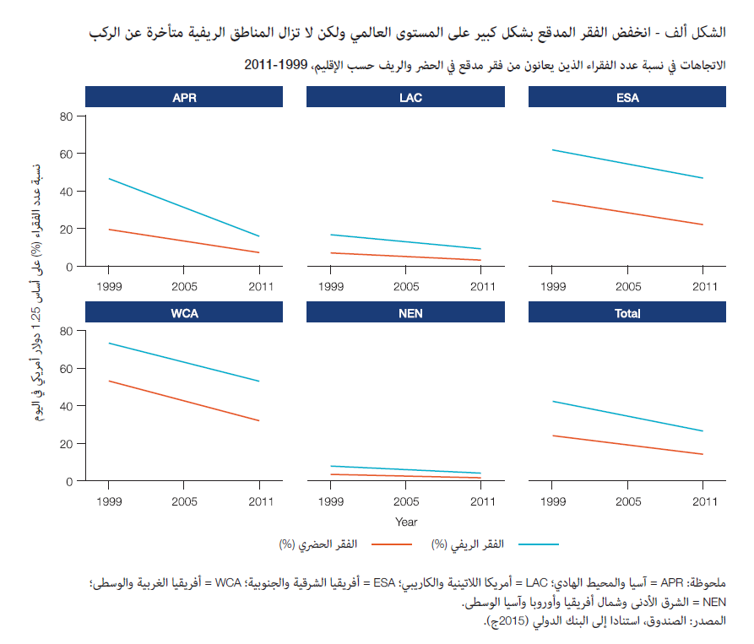
الفقر الريفي
مفهوم الفقر الريفي
الفقر المدقع
خصوصية الريف

Slide 3
Then.. What is the rural development?
Rural development is a strategy designed to improve the economic and social life of rural poor.
It is a process, which aims at improving the well being and self realization of people living outside the urbanized areas through collective process.

Slide 4
The Concept..
Rural Development is all about bringing change among rural community from the traditional way of living to progressive way of living. It is also expressed as a movement for progress.

Slide 5
The United Nations defines Rural Development as:
“Rural Development is a process of change, by which the efforts of the people themselves are united, those of government authorities to improve their economic, social and cultural conditions of communities in to the life of the nation and to enable them to contribute fully to national programme.”

Slide 7
Why we work for rural development?
1. To develop farm, home, public service and village community.
2. To bring improvement in producing of crops and animals living condition.
3. To improve health and education condition etc. improvement of the rural people.
4. To improve villagers with their own efforts.
5. To improve village communication.

Slide 9
Constraints against the R.D.
1.People related
2. Agricultural related problems
3. Infrastructure related problems
4.Economic problems
5.Social and Cultural problems
6.Leadership related problems
7.Administrative problems

Slide 10
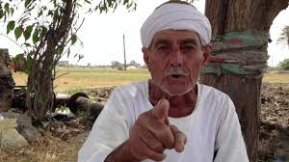
PEOPLE RELATED PROBLEMS

Slide 11
PEOPLE RELATED PROBLEMS..
1. Traditional way of thinking.
2. Poor understanding.
3. Low level of education to understand developmental efforts and new technology.
4. Deprived psychology and scientific orientation.
5. Lack of confidence.
6. Poor awareness.
7. Low level of education.
8. Existence of unfelt needs.
9. Personal ego.

Slide 12
Thank you

